Slide 1
Approach To Broncheactaisis

Slide 2
Bronchiectasis
Syndrome not a disease
Chronic illness → cough, sputum , SOB
Acute infectious exacerbation
Repeated hospitalization & ER visits

Slide 3
Bronchiectasis
Causes
1) Incomplete drainage of secretions
Congenital → Cystic fibrosis ,
ciliary dyskinesis
Compression→ Lymph node ,Thyroid
Obstruction → Tumor , foreign body

Slide 4
Bronchiectasis
2) Impairment of immune system
Immunoglobulin deficiency
complement deficiency
HIV
3)Virulent Organism
Bacterial , TB , Fungal & Viral

Slide 5
Bronchiectasis
Diagnosis
Clinical → chronic cough ,sputum
Radiological → CXR , CT
Find the cause → CBC , Ig level

Slide 6
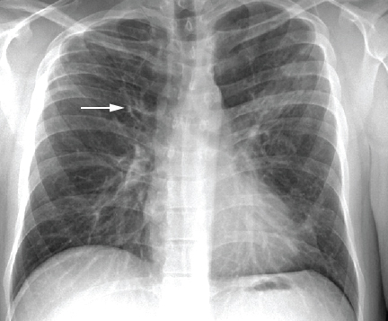
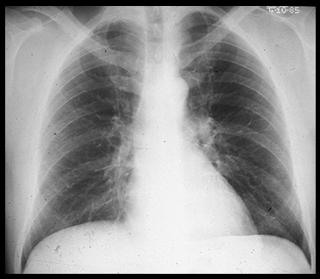

Slide 7
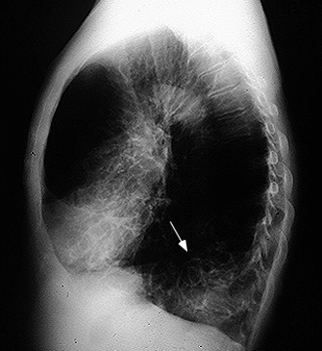
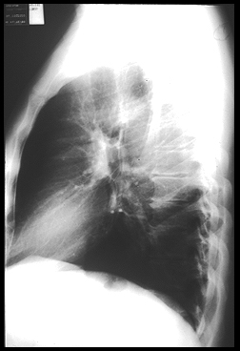

Slide 8
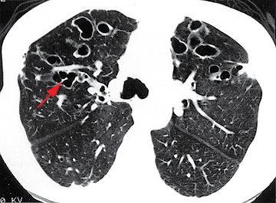
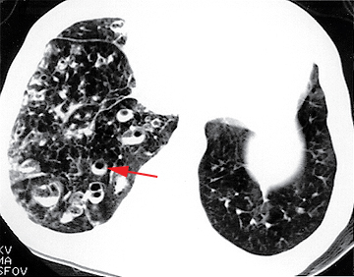

Slide 9
Bronchiectasis
Treatment
1) treat the cause to prevent prgression
2) Antibiotic
3)Bronchodilator
4)Chest physiotherapy to promote drainage
5)?Mucolytics
6)Surgey

Slide 10
Thanks

